Slide 1
Happily together: F# and T-SQL
Dmitry Morozov, DMITRY SEVASTIANOV
AUGUST 26, 2014

Slide 2


F# full stack software engineering team
IOS, Xamarin, WebAPI, WebSharper (prototype), Data Science, Machine Learning, Python Integration (future plans), Fake, Data Access etc.

Slide 3
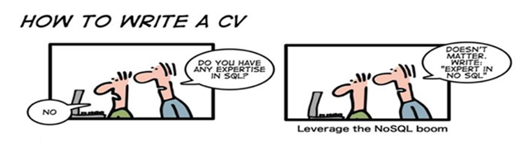
SQL server as storage engine
This is not SQL vs “NoSQL” discussion

Slide 4
Interesting facts from TIOBE Index
T-SQL – "Programming Language of the Year“ in 2013
The award is given to the programming language that has the highest rise in ratings in a year.
F# - as of today moved up 37 places since July 2013
Both are doing remarkably well

Slide 5
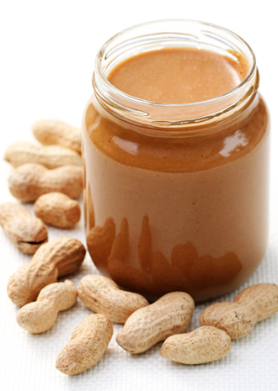
If both are so good LET’S JUST ADD them UP WHAT POSSIBLY CAN GO WRONG ?

Slide 6

The Vietnam of Computer Science

Slide 7
T-SQL DATA ACCESS OPTIONS for F# developers
 | Pros | Cons
ADO.NET | Performance Control | No Static Types Weak Abstraction
ORM - EF | Easy to start Productivity Static Types | Leaky Abstraction No Control (slow, weird T-SQL) Manual Types Re-generation
Light ORM - Dapper | Performance Static Types ??? | Hand-Written Types Weak Abstraction
Classic Type Provider + Query Builder – SQLProvider | Productivity Static Types | No Control (slow, weird T-SQL) Unsupported mappings

Slide 8
SqlCommandProvider Bridging the gap between F# types and T-SQL scripting
Statically Typed Input Parameters
Statically Typed Output
Both fully and accurately inferred
Configuration: connection

Slide 9
SqlCommandProvider – ADVANCED FEATURES
All Parameters Optional
Updates
Data binding
IOC support

Slide 10
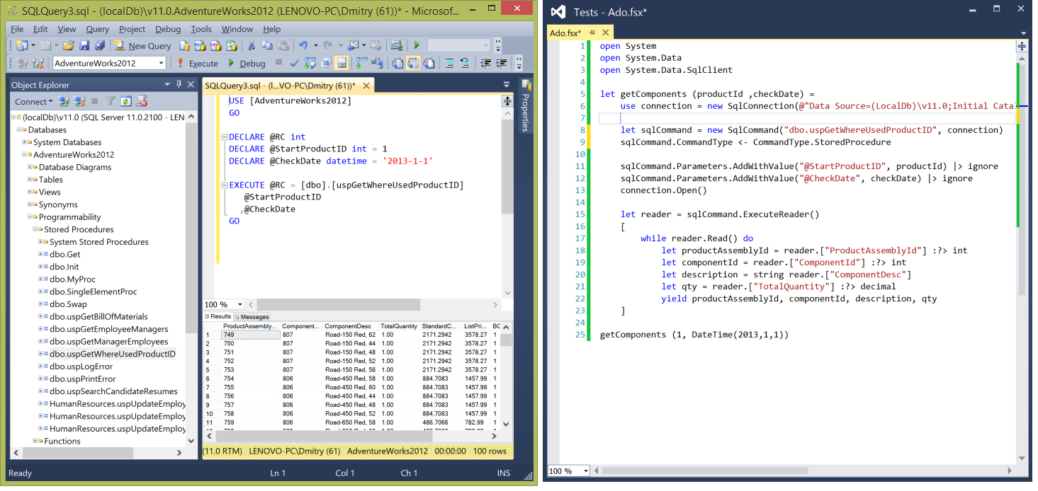
SqlProgrammabilityProvider Enterprise development with SQL

Slide 11
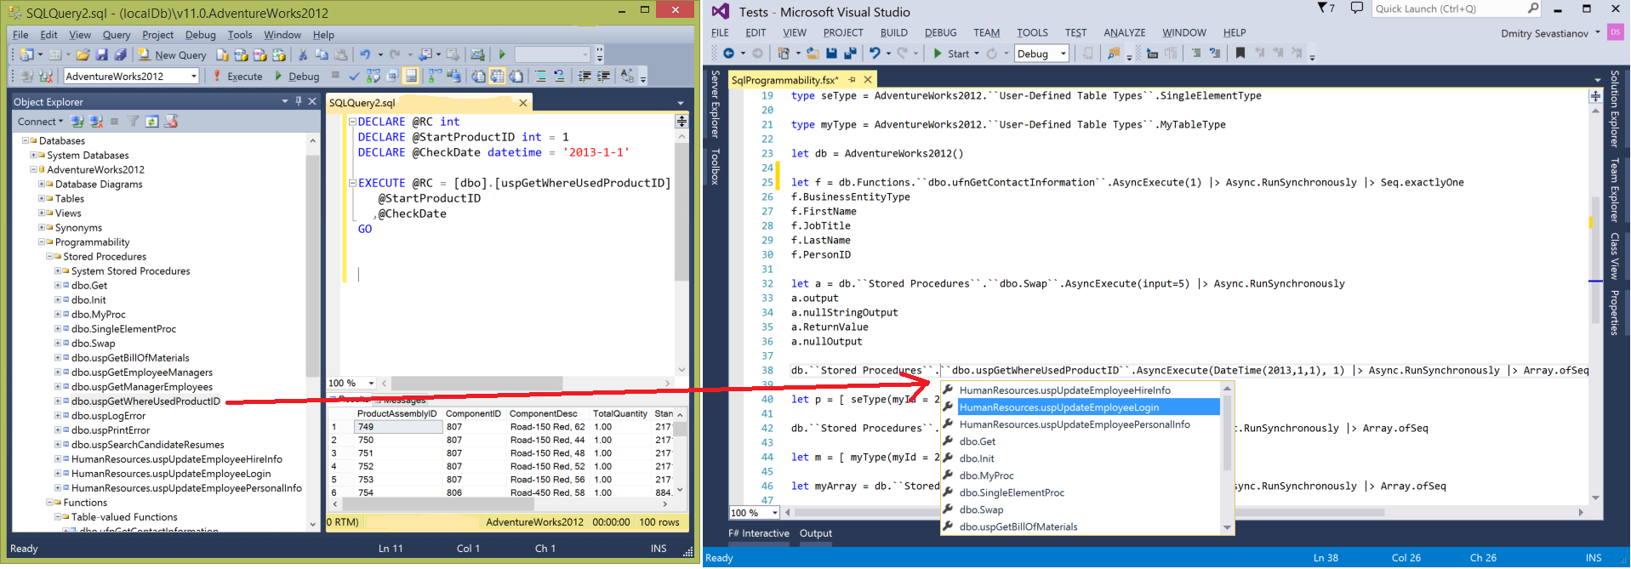
SqlProgrammabilityProvider SSMS Object Explorer with IntelliSense

Slide 12
SqlProgrammabilityProvider Features at glance
SSMS Object explorer in Visual Studio IntelliSense
Stored procedures, table-valued user-defined functions, user-defined table types
Microsoft.SqlServer.Types:
SqlHierarchyId
SqlGeography
SqlGeometry

Slide 13
SqlProgrammabilityProvider Summary
Connection string retrieval similar to SqlCommandProvider
Support for default parameters in Stored Procedures
Support for output parameters and ReturnValue in Stored Procedures
Support for User-Defined Table Types – both for Stored Procedures and Table-valued UDFs

Slide 14
Bonus - SqlEnumProvider
Enumeration for database static lookups

Slide 15
FUNCTIONAL T-SQL architectures
Good parts (data retrieval)
Expression-based abstractions (aka Table Expressions): Tables, Views, TVF, CTE
Recursion support – Common Table Expressions
Composition via APPLY operator (or JOIN)
Table Expression Type (row set) + APPLY = MONAD
Namespaces
Bad, imperative parts
Update in place by default (embrace DATOMIC or at least Event Sourcing )
No Static Types

Slide 16
Future developments
More responsive IDE experience
Even better docs and examples
New Type Providers syntax

Slide 17
SUMMARY
Data access in T-SQL can be pleasant exercise
http://fsprojects.github.io/FSharp.Data.SqlClient/
Quite good docs and sample projects
Follows F# OSS standards

